Slide 1
TGPLAN
Water Pollution
By: Jack Hollister, Jaya Twill, Miles Brown, William Whitfill, Jules Anderson and Rachel Grubbs

Slide 2
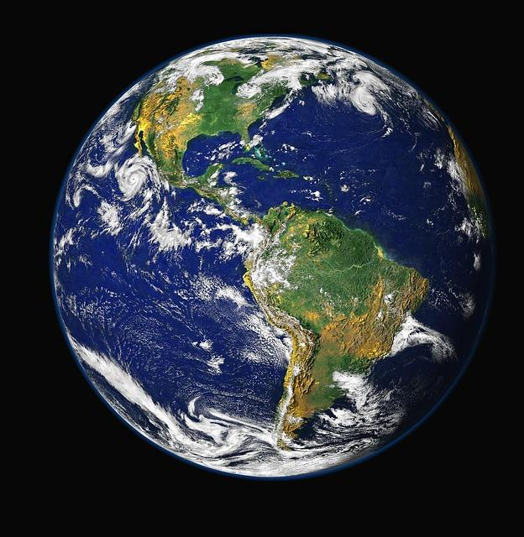
TGPLAN
Think Globally
Plan Locally
Act Neighborly

Slide 3
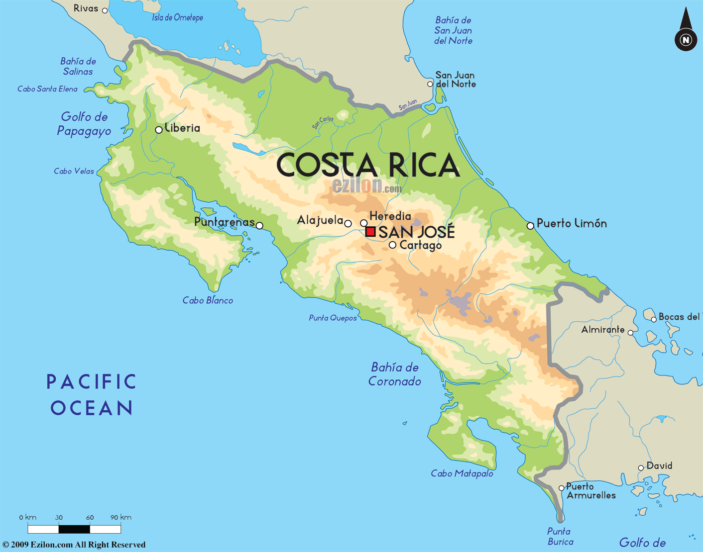
The Beginning
While we were in Costa Rica we witnessed lots of plastic pollution
Many rivers, streams, and waterfalls were littered with garbage

Slide 6
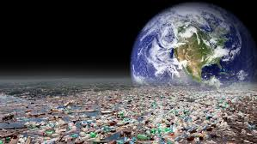
Global Impact
Fourteen billion pounds of garbage mostly plastic, is dumped into the ocean every year
Plastic waste is the cause of death of more than 100,000 sea creatures each year

Slide 7
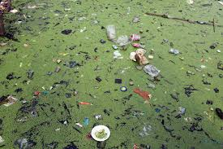
Global Impact
50% of plastic waste worldwide is used once and thrown away
Americans throw away 35 million water bottles each year
80% of water pollution is due to domestic sewage like throwing garbage on open ground and water bodies

Slide 8
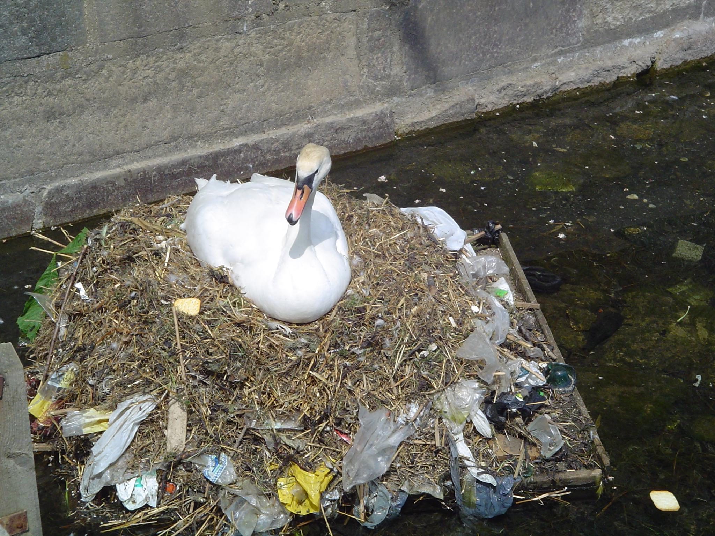
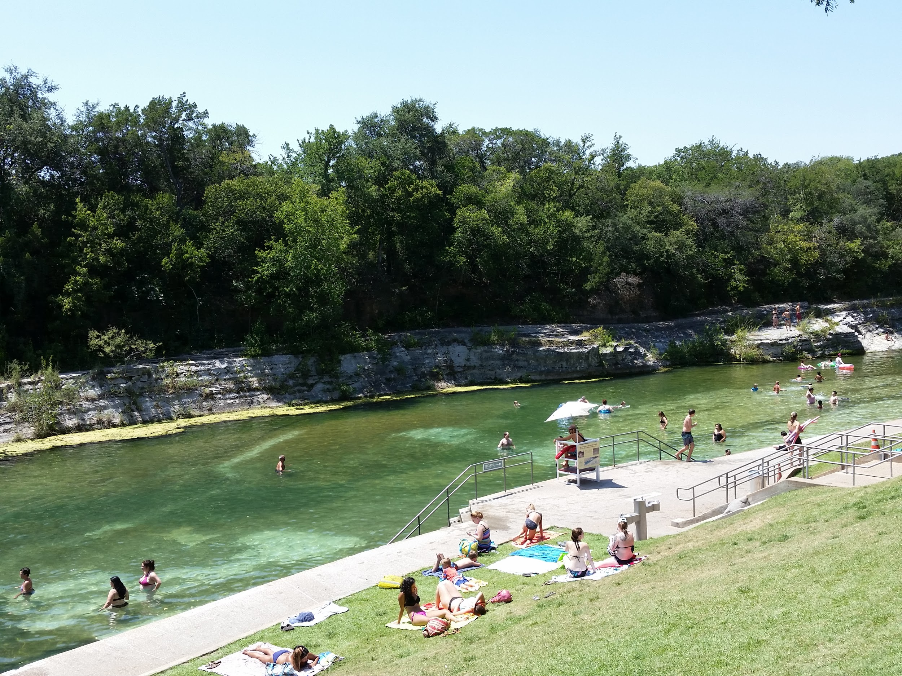
Water Pollution At Home
Austin has already made great strides with its decreased use of plastic bags.
600 plastic bags is the equivalent of 1 reusable one

Slide 9
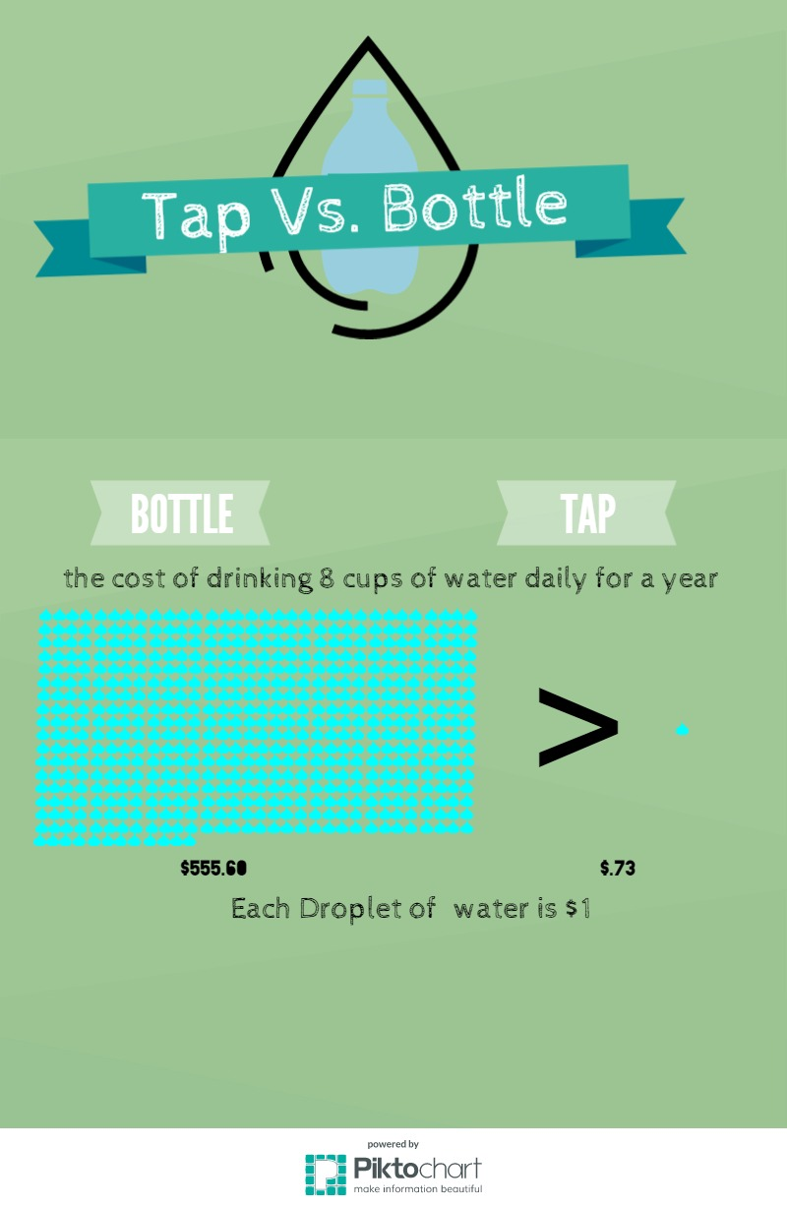
A Local

Slide 10
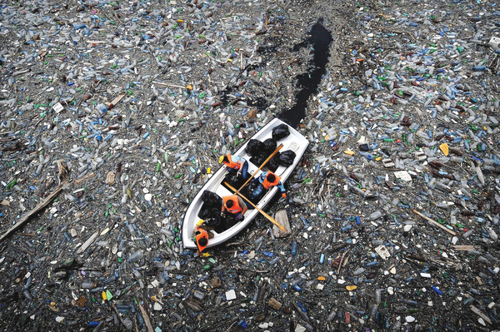
Last year, the average American used 167 disposable water bottles, but only recycled 38

Slide 11
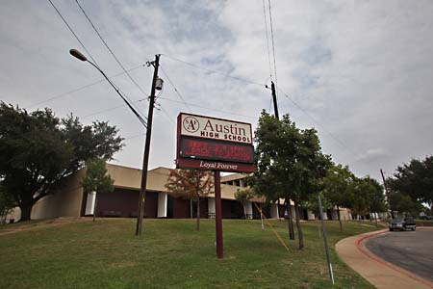
Austin High has roughly 2040 students, if each student uses 168 bottles a year, that means 342,729 bottles per year are used but only 75, 400 will be recycled, leaving 267,320 to end up in the landfills or in our oceans.

Slide 12
Our goal
In order to address water pollution in our community we needed to stop the root of the problem and find a long lasting solution
We want to bring awareness to this issue and get Austin High students to start thinking about their impact on the world

Slide 13
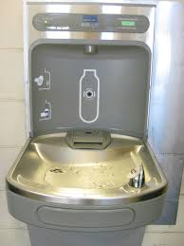
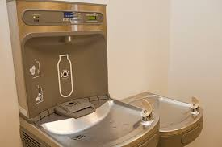
Our Take Action
Over the past few weeks our TGPLAN group has raised almost $3,000 in donations in order to install water bottle refill stations throughout our school

Slide 14
Ways to Prevent Water Pollution
Conserve water at home to limit the amount of water that needs treatment from a water treatment facility
Do not wash or flush any contaminants down any drains
Properly dispose all waste and don’t dump in direct waterways especially
Take part in a river or lake clean up in your community.

Slide 15
Advocacy
www.plasticwaterpollution.weebly.com
http://reusebottles.weebly.com/take-action.html

Slide 16
Our Sources
"40 Facts About Water Pollution - Conserve Energy Future." ConserveEnergyFuture. 13 Nov. 2013. Web. 29 Apr. 2015.F
"22 Facts About Plastic Pollution (And 10 Things We Can Do About It) » EcoWatch." EcoWatch. N.p., 07 Apr. 2014. Web. 29 Apr. 2015.
“Bottle Water Is Wasteful. “The Water Project. N.p., n.d. Web. 29 Apr. 2015

