Slide 1
Packaging Efficiency Project
By: Jack Hollister and Luna Elmur

Slide 2
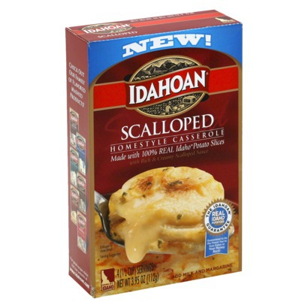
Our Product
For our product we had Idahoan scalloped potatoes
The product is 565cm³
We found this through the overflow method
The packaging volume is 996.7cm³
We found this through multiplying the dimension of the box
The box contain 43% airspace
We found this by subtracting the package volume from the product volume giving us the volume of air, then we divided the volume of the air by the volume of the packaging

Slide 3
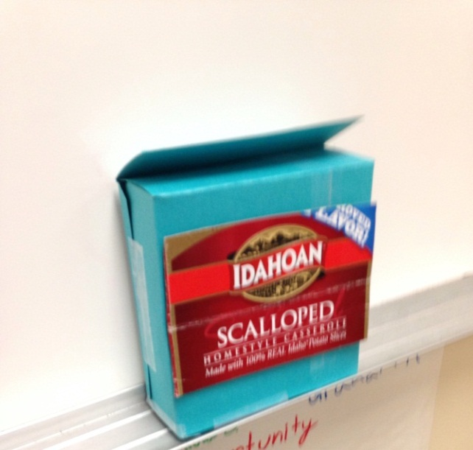
Proposed package plan
The major change we made was to cut the height from 19cm to 13cm reducing by 6cm as it seemed fairly easy but effective
The new package’s volume 681.98cm3, we found this by multiplying the new dimensions
The new package has 17% airspace, we found this by subtracting volume of package from volume of item giving the volume of the air, then we divided that by the volume of the package

Slide 4
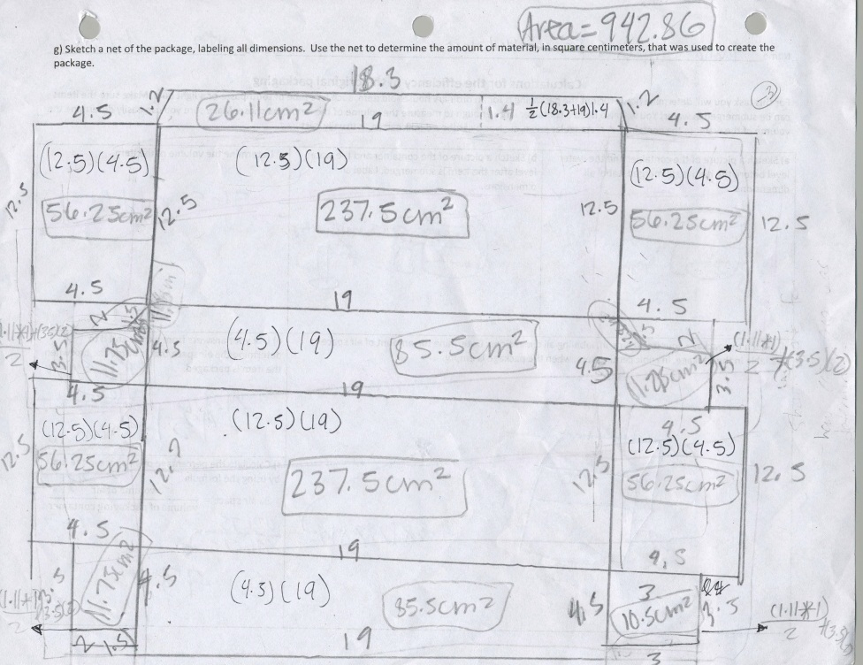
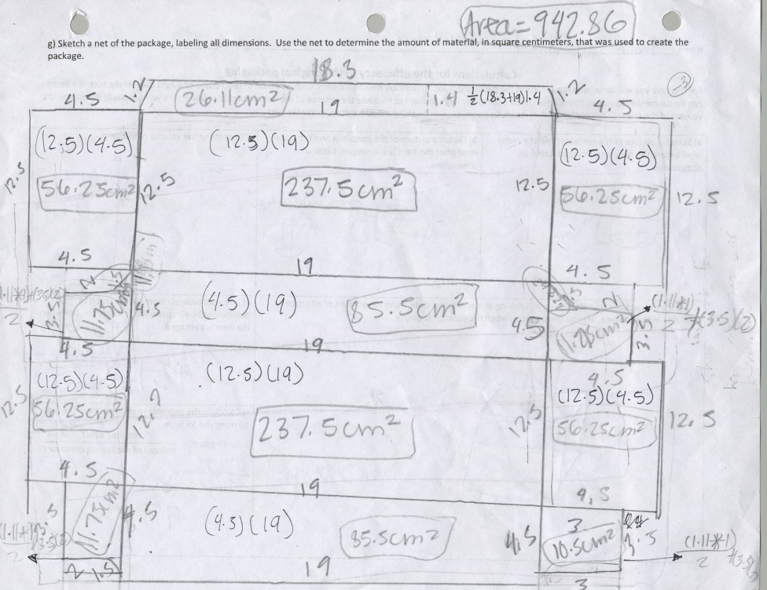
The Nets of the Packages
Original Package
New Package

Slide 5
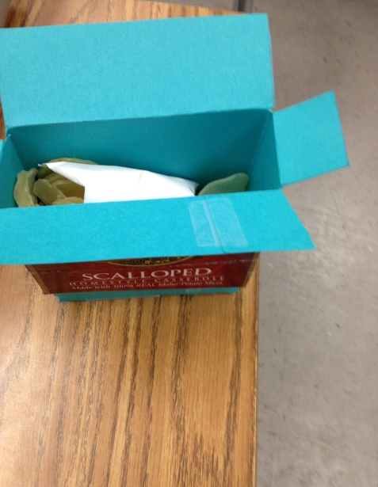
Benefits of Package
The new package has significantly less airspace than the original package
The new packaging still holds the product quite well
The new package still maintains its shape as a rectangular prism so its still very easy to work with.
The new package will save the manufacturer money as the box will cost less to make and ship because of its smaller size
It is also going to be easy for the manufacturer to implement the changes as all they have to do is cut down the height.

